Slide 1
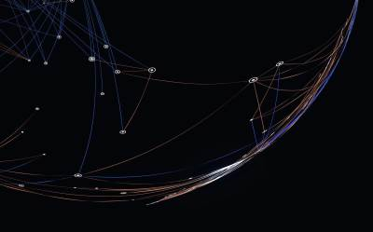
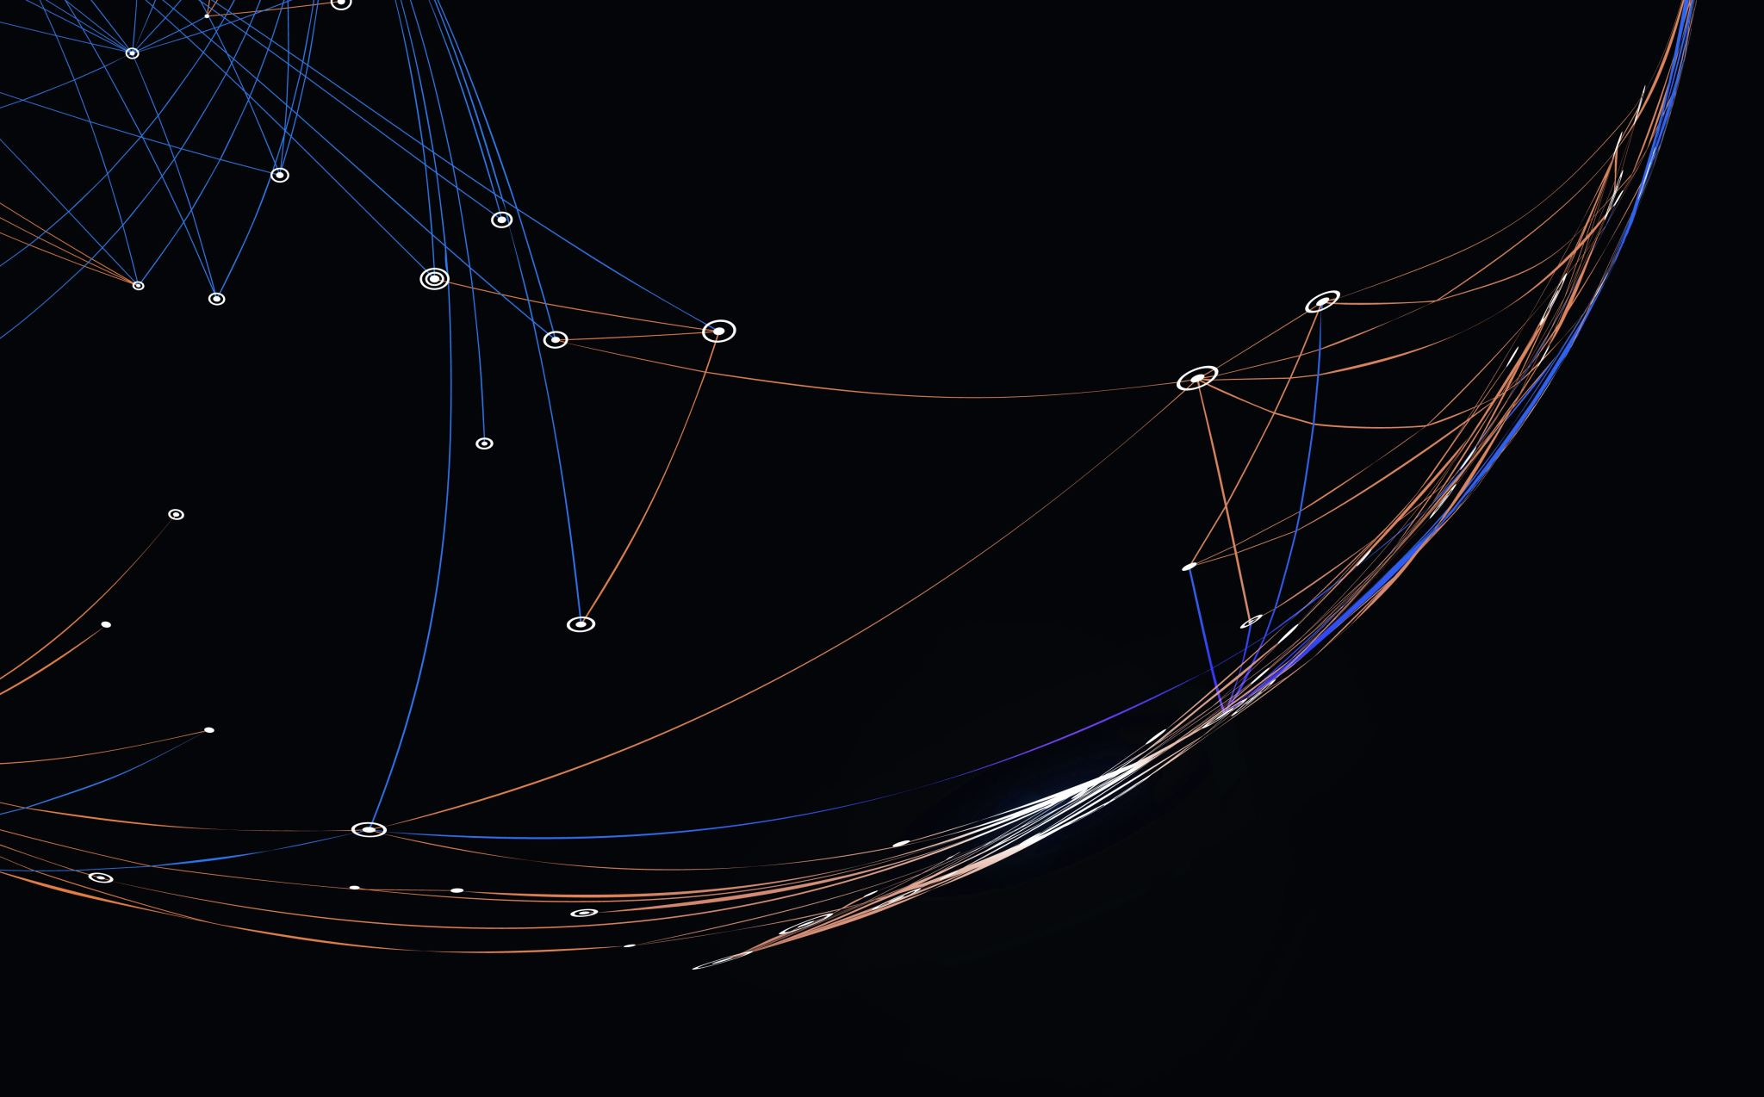
Face Mask Detection using Deep Learning
Pavly Saleh
101314216

Slide 2
Introduction
COVID-19 pandemic has highlighted the importance of wearing face masks
Monitoring the use of masks in crowded areas can be challenging
Proposed solution: deep learning techniques to detect whether a person is wearing a mask or not
Deep learning has shown impressive results in image classification tasks and can detect patterns in images without handcrafted features
Objective of the project: compare the performance of two different deep learning techniques, CNN and Transfer Learning, for detecting face masks and presenting numerical results for the selected technique
The system can be used post-pandemic to prevent the spread of other viruses in buildings with immunocompromised patients, such as hospitals and hospices

Slide 3
Background
Face mask detection is a challenging task because it involves identifying a small object on a large background
Traditional computer vision techniques may not be accurate enough for this task because of the variations in mask types, lighting conditions, and camera angles
Deep learning can help in overcoming these challenges by learning features directly from the data
CNN and Transfer Learning are two deep learning models proposed for image classification tasks
In this project, the performance of a CNN and Transfer Learning approach were compared using pre-trained models such as MobileNetV2 and VGG16
By leveraging pre-trained models, the amount of training data and time required to develop our solution was reduced
Using transfer learning, a face mask detection solution that can be used in real-time applications was developed

Slide 4
System Description
Dataset: 3,000 images of masked and unmasked people, split into training and testing sets with a 75/25 ratio
Approach: Transfer Learning and CNN
Transfer Learning is a technique that adapts pre-trained models to smaller-scale problems, reducing the training time and increasing the accuracy of the model
CNN is a deep learning technique commonly used for image classification tasks that can learn features directly from the data

Slide 5
Transfer Learning & CNN
Transfer Learning: MobileNetV2 pre-trained model, with additional global average pooling and dense layers. Only new layers trained using Adam optimizer and categorical cross-entropy loss function
CNN: Two convolutional layers, two max-pooling layers, and two dense layers, using ReLU activation for all layers except softmax for the output layer. Same optimizer and loss function as the transfer learning model

Slide 6
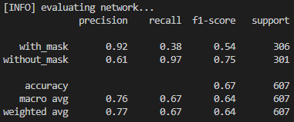
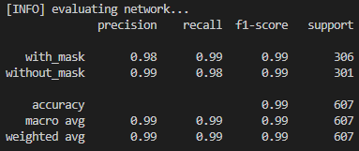
Training Stats
CNN Training Stats
Transfer Learning Training Stats

Slide 7
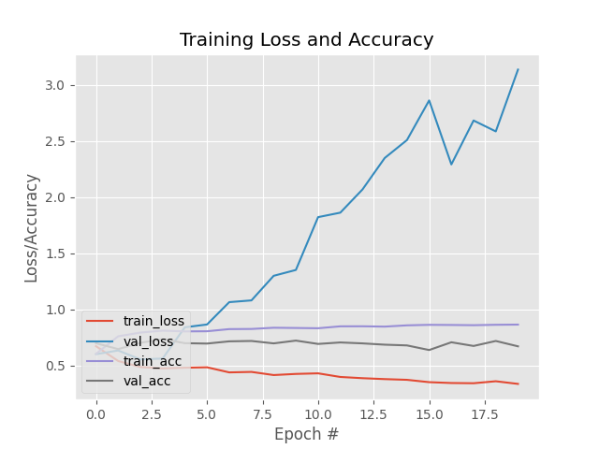
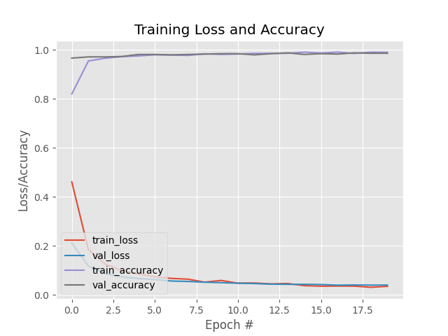
Graphs
CNN
Transfer Learning

Slide 8
Confusion Matrix
Transfer Learning Model
 | With Mask | Without Mask
With Mask | 1470 | 15
Without Mask | 30 | 1485
CNN Model
 | With Mask | Without Mask
With Mask | 1380 | 585
Without Mask | 120 | 915

Slide 9
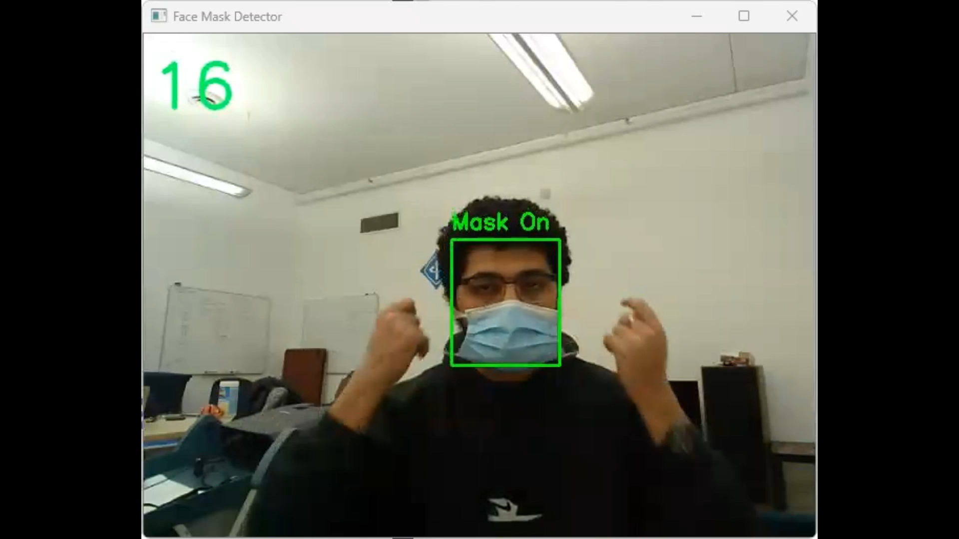
Demo

Slide 10
Conclusion
Developed 2 models to detect face masks in images: Transfer Learning and CNN
Compared the performance of both models and found that Transfer Learning outperformed CNN on all metrics
Results demonstrate effectiveness of Transfer Learning in image classification tasks, especially with limited datasets
Models can be used as foundation for more advanced systems

